Slide 1


ACME A powerful ADL
Project 2
OP5
ADL presentation
Euro Team
Alauzet Pierre, Ahvenniemi Mikko,
Colin Julien, Starck Benoit
CS554 - Design for Software &Systems

Slide 2
Table of Contents
Why do we use ADLs ?
ADL investigation & choice
ACME presentation
ACME Particularities
ACMEStudio
ADLs Comparison

Slide 3
1. Why do we use ADLS ?
Why do we use ADLs?
ADL Choice
ACME Presentation
ACME Particularities
ACMEStudio
Comparison
Necessity of using standardized architectural representation
ADLs bring standards for architecture description, just as what
UML do for design
Entity-relationship model do for database
Using architectural styles for the structure
Pipe and filters
Client/Server
…
Using formal language
Components
Connectors
…
Makes the architecture universally understandable
Designers
Programmers
Stakeholders

Slide 4
1. Why do we use ADLS ?(cont.)
Why do we use ADLs?
ADL Choice
ACME Presentation
ACME Particularities
ACMEStudio
Comparison
An ADL is a language for modeling a software system’s conceptual architecture, distinguished from the system’s implementation
ADLs bring the tools for architecture evolution and reusability
Makes the architecture assessable using external tools or methods

Slide 5
2. ADL investigation and choicE
Why do we use ADLs?
ADL Choice
ACME Presentation
ACME Particularities
ACMEStudio
Comparison
Comparison between several available ADLs
Abacus :
Not well provided (movies, tutorials,…) but not a lot of papers
For professional & enterprises
Software : 30 day trial
Rapide :
Best documentation and example
Software on Linux & Solaris : free BUT NOT ACCESSIBLE
Wright
Not enough documents
Well represented on Internet
No software
Unicon
Good specification
Software not available

Slide 6
2. ADL investigation and choice (cont.)
Why do we use ADLs?
ADL Choice
ACME Presentation
ACME Particularities
ACMEStudio
Comparison
We have chosen ACME !
Well known
A lot of documentation
Website
HTML large documentation
Tutorials available
Complete and well-made software as an Eclipse plug-in
Free software available on every platforms
Developed in the same university as ATAM method – Carneggie Melon University

Slide 7
3. What is acme ?
Why do we use ADLs?
ADL Choice
ACME Presentation
ACME Particularities
ACMEStudio
Comparison
Acme created in 1995 by Carnegie Mellon University
The original goal was to provide a common language that could be used to support the interchange of architectural descriptions between a variety of architectural design tools.
Provide a generic, extensible infrastructure for describing, representing, generating, and analyzing software architecture language description.
Provide descriptions that are easy to understand for everyone

Slide 8
3. What is acme ? (cont.)
Why do we use ADLs?
ADL Choice
ACME Presentation
ACME Particularities
ACMEStudio
Comparison
One of ACME’s goals is to be an ADL interchange format
Facilities exist for translating ACME to Aesop, Rapide, Wright, and back
Some steps have to be taken to take full advantage of this (e.g. Wright to Rapide)
Translating specification form ADL 1 to ACME specification
Translating the annotated ACME specification in ACME specification with ADL 2 annotations
Finally, ACME code can be directly translated into ADL 2 specific description

Slide 9
3. Acme transformation
Why do we use ADLs?
ADL Choice
ACME Presentation
ACME Particularities
ACMEStudio
Comparison
Model Checking Tool
Acme Tools Layout Tool Aesop
Simulation Tool
Wright Specification
Rapide Specification
Acme Specification with Wright annotations
Acme Specification with Rapide annotations
Tools
ADL Tools Application
Specifications
Specification transformation

Slide 10
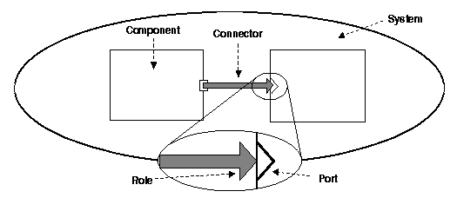
3. Acme description
Why do we use ADLs?
ADL Choice
ACME Presentation
ACME Particularities
ACMEStudio
Comparison
ACME describes a whole system thanks to
Library of 7 architectural elements
Components
Connectors
Systems
Ports
Roles
Representations
Representation maps
Architectural families
Tiered
Pipe & filters
Client & servers
Pub-Sub
Shared data
Three-tiered

Slide 11
3. Acme description
Why do we use ADLs?
ADL Choice
ACME Presentation
ACME Particularities
ACMEStudio
Comparison
Component
Primary computational elements & data stores
Filter
Object
Client/Server
Database
Black board
Connectors
Interaction among components
connector embodying HTTP protocol within a client/server architecture
data flow channel in a pipe/filter architecture
Communication & coordination among components
asynchronous communication channel such as event bus
Component
Connector

Slide 12
3. ACME Description (cont.)
Why do we use ADLs?
ADL Choice
ACME Presentation
ACME Particularities
ACMEStudio
Comparison
Systems
First ordered entity in ACME
Configuration of components & connectors
Role
Particularity of the connector
Describes how the connector links the components
Client-server connector has 2 roles designated caller & callee
Reading or writing pipe
Port
Anchorage point on the component
Describes input or ouptut of a component
Can be unique or multiple
System
Component
Connector
Component
Role
Connector
Component
Port

Slide 13
3. ACME Description (cont.)
Why do we use ADLs?
ADL Choice
ACME Presentation
ACME Particularities
ACMEStudio
Comparison
Properties
Used to define component’s or connector’s behavior
Provide a way to encoding information to be interpreted
Defines information that are likely to change within the architecture
Properties are transparent for ACME itself
Examples of ACME code and properties definitions
Example of code describing a filter architecture and his behavior defined as a propriety to be read by a Java IDE for implementation.
Component TheFilter = {
Port in; Port out;
Property implementation :
String ="while (!in.eof) {
in.read; in.read; compute; out.write}";}

Slide 14
3. ACME Description (cont.)
Why do we use ADLs?
ADL Choice
ACME Presentation
ACME Particularities
ACMEStudio
Comparison
Example of server component. The defined property represents a non-functional requirement. We want the server to respond in less than 15 ms.
This last example shows us how to rely an architectural item in ACME to another ADL
Component Server = {
Port requests;
Property responsetime :
Float = 15.00 << units="ms">>;}
Component TheFilter = {
Property external-type : "SomeADL::Filter";
Port in; Port out;;}

Slide 15
3. ACME Description (cont.)
Why do we use ADLs?
ADL Choice
ACME Presentation
ACME Particularities
ACMEStudio
Comparison
Types
A type is a ready-to-use structure prototype that can be use as an architectural template
The architect is allowed to create his own types
Types includes information that is not likely to change within the architecture
Example of type definition
Component Type EventListenerT = { Property eventMap; Property implementation; };

Slide 16
3. ACME Description (cont.)
Why do we use ADLs?
ADL Choice
ACME Presentation
ACME Particularities
ACMEStudio
Comparison
Language is based on
First order predicate logic
Rules checking if architectural model is well formed
Rules can be defined
By the style designer
By ourself
2 types of rules
Invariant : violations of which are errors
Heuristics : violations of which leads to warnings

Slide 17
4. ACME particularities
Why do we use ADLs?
ADL Choice
ACME Presentation
ACME Particularities
ACMEStudio
Comparison
Representation
Way to abstract complex system
Lower level view of a component
Component contains & represents a sub system
System
Component
Component
Connector
Subsystem

Slide 18
4. ACME particularities (cont.)
Why do we use ADLs?
ADL Choice
ACME Presentation
ACME Particularities
ACMEStudio
Comparison
ACME method allows a translation mechanism…
… using properties
Runtime semantics
Data type for communication between components
Protocols of interaction
… allowing other tools to interpret the architecture
ADL's (Wright, Unicon, etc.)
Development environments
Analysis or checker tools
Type structuring allows the architect to create templates to be
Used within a project
from one client/one server to multiple clients/multiple servers architecture
Reused in other projects involving the same kind of structure

Slide 19
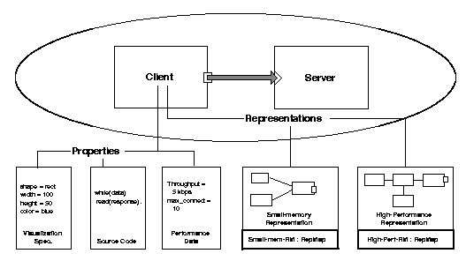
4. ACME particularities (cont.)
Why do we use ADLs?
ADL Choice
ACME Presentation
ACME Particularities
ACMEStudio
Comparison
Illustration of representation and properties of a component

Slide 20
5. Acme tool
Why do we use ADLs?
ADL Choice
ACME Presentation
ACME Particularities
ACMEStudio
Comparison
Eclipse plug-in software : AcmeStudio
AcmeStudio
Graphical interface
Architecture drawing
Design analyze
Language description (development)
Features
Create or edit families
Edit visualization
Edit and check rules
Edit properties
Etc…

Slide 21
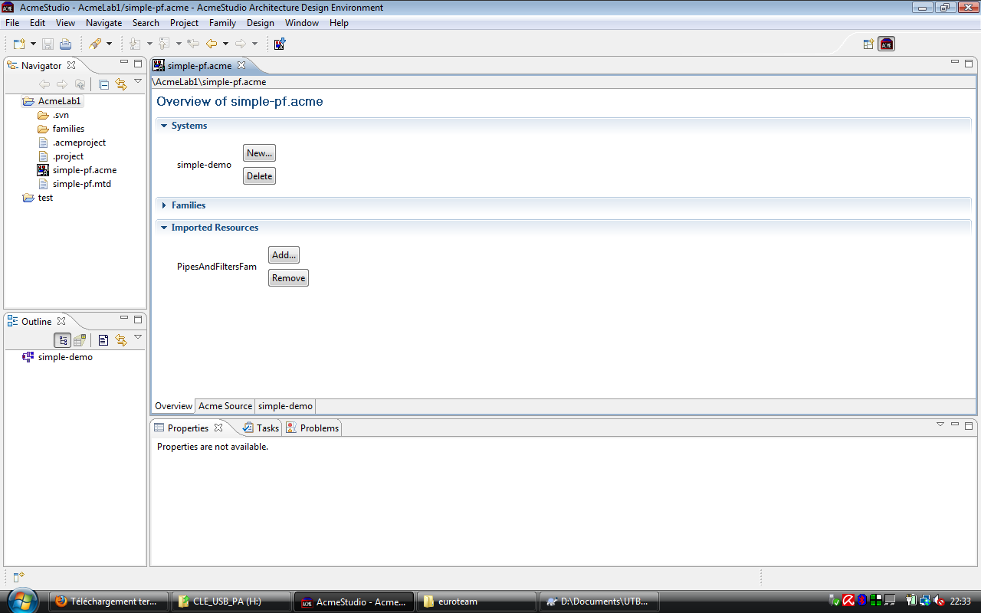
5. ACMESTUDIO
Why do we use ADLs?
ADL Choice
ACME Presentation
ACME Particularities
ACMEStudio
Comparison

Slide 22
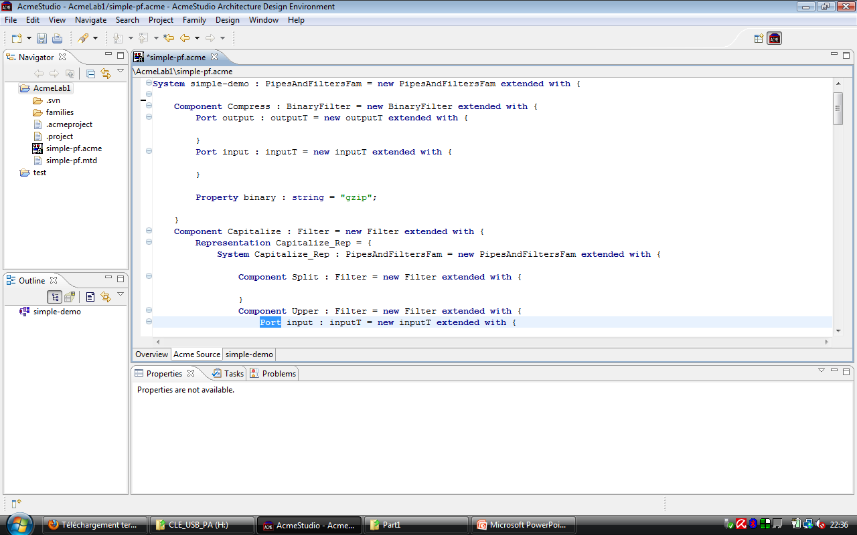
5. ACMESTUDIO (cont.)
Why do we use ADLs?
ADL Choice
ACME Presentation
ACME Particularities
ACMEStudio
Comparison

Slide 23
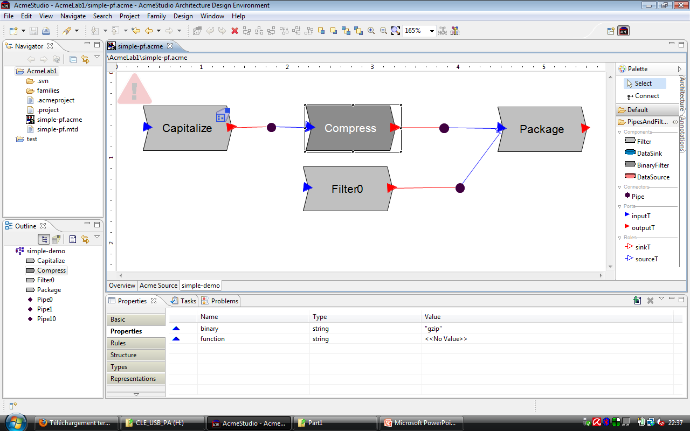
5. ACMESTUDIO (cont.)
Why do we use ADLs?
ADL Choice
ACME Presentation
ACME Particularities
ACMEStudio
Comparison

Slide 24
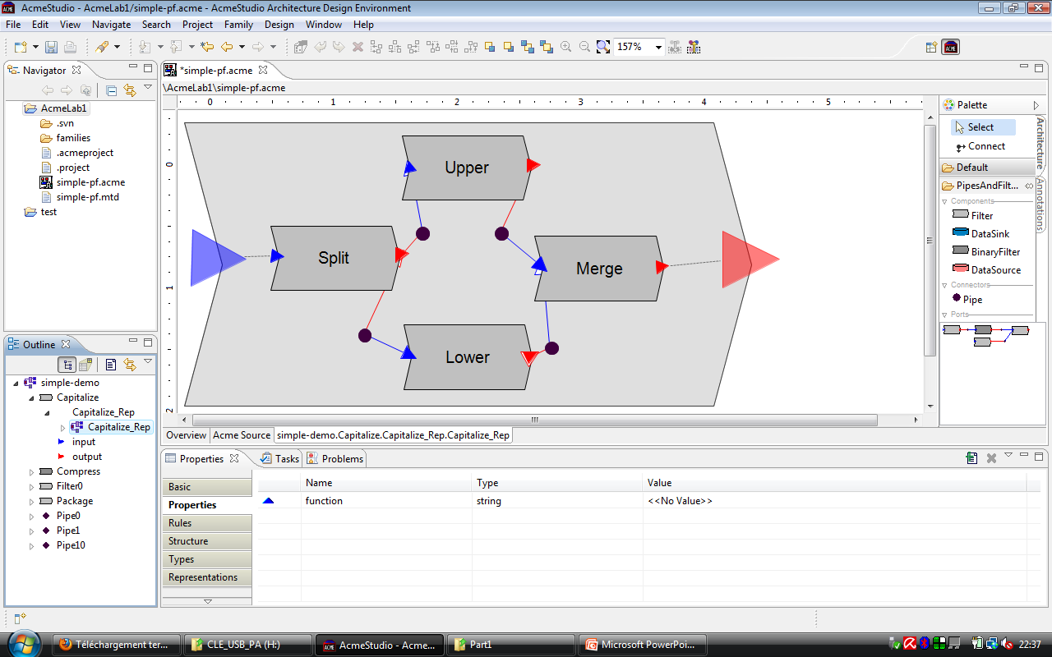
5. ACMESTUDIO (cont.)
Why do we use ADLs?
ADL Choice
ACME Presentation
ACME Particularities
ACMEStudio
Comparison

Slide 25
6. ADLs COMPARISON : the scope
Why do we use ADLs?
ADL Choice
ACME Presentation
ACME Particularities
ACMEStudio
Comparison
Comparison of scope
Scope
ACME | Darwin | Rapide | Unicon | Wright
Architectural interchange, predominantly at the structural level | Architectures of highly-distributed systems whose dynamism is guided by strict formal underpinnings | Modeling and simulation of the dynamic behavior described by an architecture | Data-flows architectures with high volume of data and real-time requirements. | Modeling and analysis of the dynamic behavior of concurrent systems

Slide 26
6. ACME : Qualities and Lacks
Why do we use ADLs?
ADL Choice
ACME Presentation
ACME Particularities
ACMEStudio
Comparison
A common interchange language:
Provide variety of tools belonging to several ADLs
Easy to use : one format for all ADLs, programmers don’t have to master all ADL’s languages
User-friendly interface
Very complete, lot of functions
Seven basics entities
Easy for the user, don’t need to learn ACME language
Group each auxiliary information from ADLs, by using properties
Ex : Property Aesop-style : style-id = clientserver;

Slide 27
6. ACME : Qualities and Lacks (CONT.)
Why do we use ADLs?
ADL Choice
ACME Presentation
ACME Particularities
ACMEStudio
Comparison
Acme provides translation between 2 ADLS
→ don’t provide advanced tools for each ADL
→ you may turn to another tool if you want describe detailed architecture
Should limit the class of systems of ADLs for translations
often important and painful trade-offs have to be made to permit the success of translation
Try to develop a translator bi-directionality will complicate the program a lot
→ loss of a main functionality

Slide 28

ACME A powerful ADL
Thankyou for attention !
Project 2
OP4
ADL presentation
Euro Team
Alauzet Pierre, Ahvenniemi Mikko,
Colin Julien, Starck Benoit
CS554 - Design for Software &Systems

Slide 29
references
David S. Wile, ACME: An Interchange Language for Architecture Representation
http://www.cs.cmu.edu/~acme/, ACME websites
http://en.wikipedia.org/wiki/Architecture_description_language, ADL wikipedia page
[KKC00] R. Kazman, M. Klein, P. Clements, ATAM: A Method for Architecture Evaluation, CMU/SEI-2000-TR-004, Software Engineering Institute, Carnegie Mellon University, 2000.

